Slide 1
48024 Applications Programming
Dr Angela Huo

Slide 2
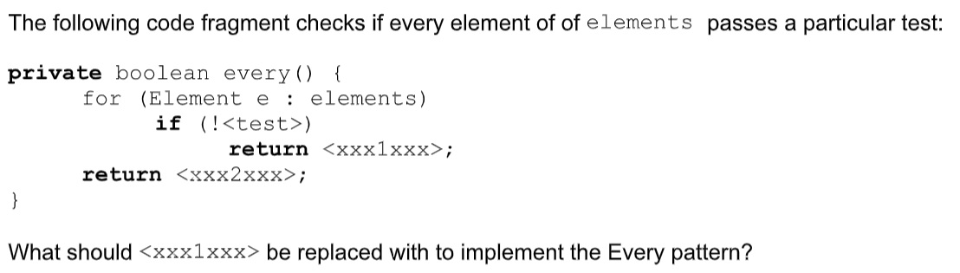
Quiz

Slide 3
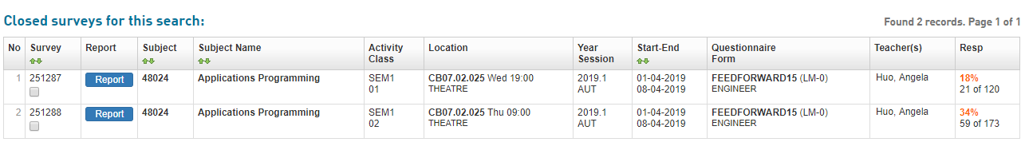
EFS Survey
The online Early Feedback Survey (EFS) for Autumn session is now open for student feedback.
https://www.sfs.uts.edu.au/

Slide 4
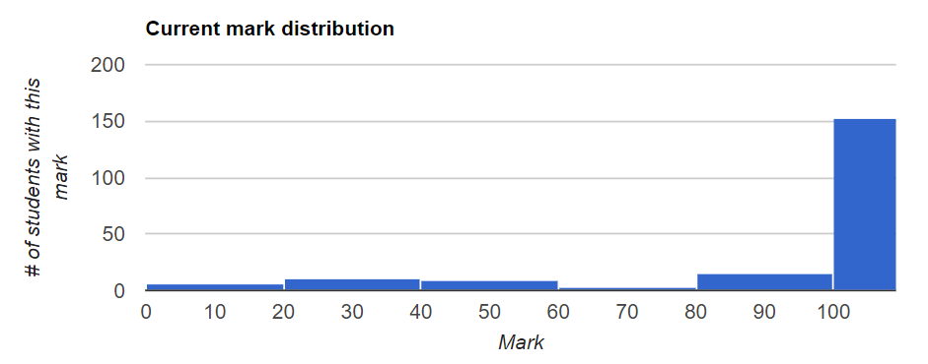
Lab 4 Review

Slide 5
Lab4 Review Lab5 Review
Procedural Programming
Incremental Goals
Top-Down & Bottom-up
OO Design Principles
Class and Objects
Inheritance

Slide 6
Object Oriented Programming
Static
Instance
Final: can’t change after initialized
Shell | OS Core
Stack | Local variables
Heap | New and alloc
Read&Write | Global & Static
Read Only | Code&Constant
unallocated

Slide 7
Access Control
Public
Protected: Self, subclass, package
Private: inner
Default: Self, Package

Slide 8
Constructor
Same name after class
No return type
No “void”
Run with “new”

Slide 9
Constructor
Overloading
Differentiate by parameters
This—current object

Slide 10
Other Methods
toString: Override
Setter
Getter
jacksAccount = janesAccount?

Slide 11
Lab 5
From this week, the scale of projects that students work on gets bigger, so we do analysis together as a class and get them onto the coding sooner.
For the Goals Matrix
list the goals down the left first,
then distribute the methods across the classes.
----- This chart basically captures the content of a class diagram in a more concise way, and allows you to see how one goal can distribute across several classes more easily.

Slide 12
Pattern book
3 constructor patterns, formatted, the menu pattern
Unfamiliar ones
initialising a field with a new object, toString.

Slide 13
Coding--skeleton code
Code the classes and fields.
PLATE will check your fields. They must be private otherwise your exercise won’t be marked.
If the names are not right, check the PLATE feedback as to what to rename the fields to.
Code the constructors.
Decide whether a field is initialised from a default value, a read pattern or a parameter.
PLATE will also check this.
Code each goal.
Code the complete goal so that it cuts across the classes. If you do this, you will be able to
receive marks right from the start as you knock off each goal.

Slide 14
Coding-Skeleton
Two Rules:
(1) one method per goal,
(2) good names per method.
This makes code more reusable and more readable. For example, while writing the client code for withdraw:
if (account.has(amount))
account.withdraw(amount);
The has() function is both reusable and reads almost like English.

Slide 15
Coding-Menu
Please do the menu goal first.
Of course each menu action points to an empty procedure at this stage so each action does nothing. But run it and show them that the menu works, even though the actions don't work yet. Then knock off each action.
After you submit the constructors, you should look at what PLATE is trying to test next, and that is how you should decide which goal you should implement first.
Just implement things in the order that PLATE tests them. So, menu first!

Slide 16
Timing
30 min Intro + Demo
10 min analysis
Remaining time -- Coding
See you next week!

Slide 17
Contact
Subject Coordinator and Lecturer: Angela Huo
Email: huan.huo@uts.edu.au
Contact information on UTSOnline

Slide 18
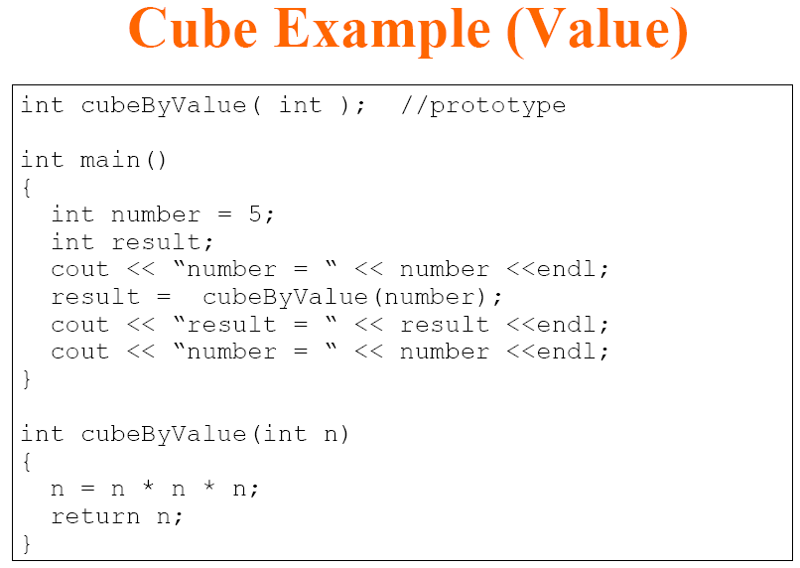
Parameter Passing

Slide 19

Value Example Result

Slide 20
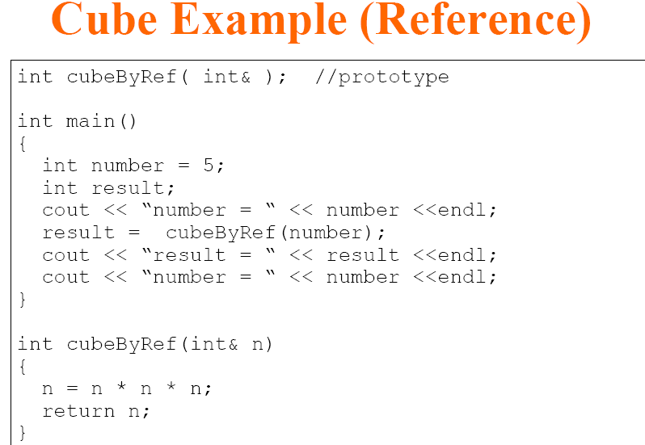
Parameter Passing

Slide 21

Reference Example Result

